Slide 1



Slide 2



 | Slope Bins 4 | Smear Count 25
Block number | Alpha w/ Henderson Hasselbalch | Chi Chi_max = 2.2
[0 50] | 0.040012 | 1.160000
[50 75] | -0.278451 | 0.720000
[75 125] | -0.519707 | 0.608000
[125 156] | -0.154453 | 0.529032

Slide 3


 | Slope Bins 4 | Smear Count 31
Block number | Alpha w/ Henderson Hasselbalch | Chi Chi_max = 2.2
[0 31] | 0.001103 | 0.922581
[31 62] | -0.386873 | 0.703226
[62 93] | -0.290146 | 0.967742
[93 496] | 0.037164 | 1.098759
[496 527] | -0.064533 | 0.819355
[527 620] | 0.010682 | 0.756989
[620 647] | -0.103326 | 0.696296

Slide 4
Approach
B, and v will be different for L and H
Chi should be same
Match pure L and H first, then mix
SCFT Purpose:
Additional information of underlying protein organization
Possible underlying conformational change driven by Cs

Slide 5
Summary

Slide 6







v2.7 and some fine
b1.50 v2.7 c3.2
b1.75 v2.7 c3.2
b1.75 v2.5 c3.2
b1.75 v2.5 c3.0
b2.0 v2.7 c3.2
b2.25 v2.7 c3.2
b2.50 v2.7 c3.2
Phi too small to decrease v0

Slide 7










b2.0 v2.0 c3.0
b2.0 v10.0 c3.0
b2.0 v8.0 c3.0
b2.0 v6.0 c3.0
b2.0 v4.0 c3.0
Phi limit
b1.8 v10.0 c3.0
b1.8 v8.0 c3.0
b1.8 v6.0 c3.0
b1.8 v3.0 c3.0
b1.8 v2.0 c3.0
Phi limit

Slide 8



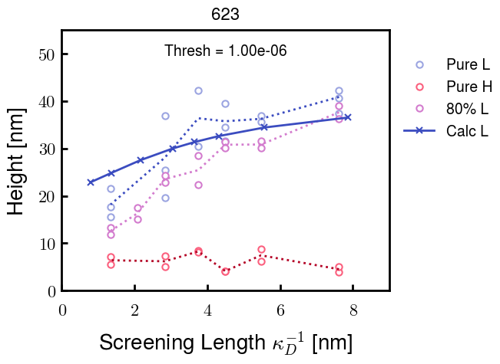
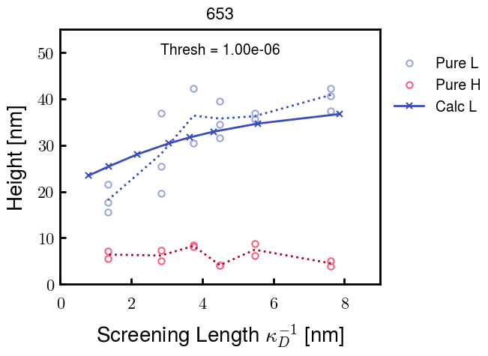
b1.6 v10.0 c3.0
b1.6 v8.0 c3.0
b1.6 v6.0 c3.0
b1.6 v2.0 c3.0
b1.6 v1.5 c3.0
Phi limit

Slide 9









b2.0 v2.7 c3.2
b3.0 v3.5 c3.5
b3.0 v7.0 c3.5
b3.0 v7.0 c3.0
Phi too small
Phi too small to decrease v0
b4.0 v12.0 c3.0
b5.0 v20.0 c3.0
b5.0 v20.0 c4.0
b5.0 v5.0 c3.0
b5.0 v10.0 c3.0
Phi too small to decrease v0

Slide 10





v20
b5.0 v20.0 c3.0
b4.5 v20.0 c3.0
b4.0 v20.0 c3.0
b3.5 v20.0 c3.0
v10
b5.0 v10.0 c3.0
b4.0 v10.0 c3.0
b3.0 v10.0 c3.0
b2.0 v10.0 c3.0

Slide 11




b2.00 v2.70 c3.20
b2.00 v2.75 c3.20

Slide 12
NFH fitting (from NFL best fit)

Slide 13








b1.00, v0.50, c3.2
b2.00, v4.00, c3.2, th2.5e-02
b1.00, v2.00, c3.2
b1.00, v1.00, c3.2

Slide 14
Mixture

Slide 15



Slide 16


b = 0.75

Slide 17





Slide 18
b = 1.0

Slide 19





Slide 20
b = 1.25

Slide 21




Chi 2.6
Bad vol frac

Slide 22








b25v0
b25v1
b25v2
b25v3

Slide 23




Chi 2.8
Bad vol frac

Slide 24





Slide 25
b = 1.50

Slide 26






Chi 2.8
Bad vol frac

Slide 27





Slide 28

b = 2.00
v4 = 0.25*b^3

Slide 29


Bad vol frac

Slide 30



Slide 31
Fine tune

Slide 32



b1.25, v1.95, c3.0
b1.50, v3.38, c3.0
b2.00, v4.00, c3.0
Norm seems to capture kinked behavior

Slide 33




Slide 34



b1.25, v1.95, c3.2
b1.50, v3.38, c3.2
b2.00, v4.00, c3.2

Slide 35




Slide 36


b1.25
b1.50
b2.00
c2.8
c3.0
c3.2

